Slide 1
Auto Focus Network

Slide 2
High Level Block Diagram
XY Coordinates
Obtain XY tile coordinates via micro magellan surface
Choose Tiles
Determine which tiles to focus on
Capture 3 plane images
At each determined tile, capture full frame images from 3 different z planes
Gaps between z planes is predetermined
Break Images into super pixels
Calculate reciprocal Brenner Score
Filter Brenner Score
Divide each image into an array of sub areas dubbed ‘super pixels’
Calculate brenner score for each super pixel and take reciprocal of it
Brenner score is pixel(col, row) – pixel(col + n, row).
Filter out background super pixels via ‘Well Depth’
Make Focus Prediction
Take 3 point reciprocal brenner score, solve quad equation and solve for derivative = 0 to find projected focus position. Use Gauss-Jordan reduction to solve
Fit Plane
Fit best plane to all points (X,Y, Predicted focus z position)
Use outlier dampening loss function to best fit with
Populate Focus Map
Use Plane(XY coordinates) to determine Z position for focus map
Pop FM array with depth of focus across 1 FOV
Z value in FM is top value. Work down when capturing more planes

Slide 3
Needed Methods
Generate FM array [x kinda]
Generate super pixel array(sp_y, sp_x, channel) [x]
Image subdivider [x]
Integrate image into super pixel array (image, channel) [x]
Tile chooser [x]
Auto Focus(channel)
Well Depth filter
Focus prediction populator
Plane fitter
Plane 2 FM map

Slide 4
FM Array Constructions
Contains all channel info
Numpy array with dimensions (10, y_tiles, x_tiles). X and Y tile count come from Micro Magellan array
Dtype = int16
9
Number Z slices A647 with depth of focus step sizes
8
Top Z position A647
7
Number Z slices A555 with depth of focus step sizes
6
5
4
3
2
1
0
X positions
Y positions
Top Z position DAPI
Number Z slices DAPI with depth of focus step sizes
Number Z slices A488 with depth of focus step sizes
Top Z position A555
Top Z position A488

Slide 5
Super Pixel Array Array Constructions
1 Array per channel.
Numpy array with dimensions (5, y_super_pixel_count, x_super_pixel_count, 2).
y_super_pixel_count = int(super_pixels+per_image * y_tile_count *overlap_adjuster)
Dtype = float64
4
3
2
1
0
[Reciprocal Brenner Score plane 1, Z position]
[Reciprocal Brenner Score plane 2, Z position]
[Reciprocal Brenner Score plane 3, Z position]
[Predicted Focus Z position, Nothing]
Super Pixel Mask
[All pixels 0 or 1, Nothing]

Slide 6
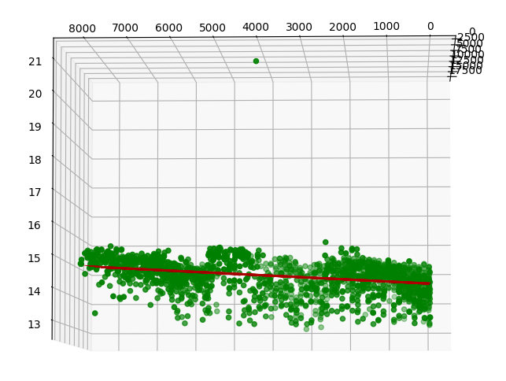
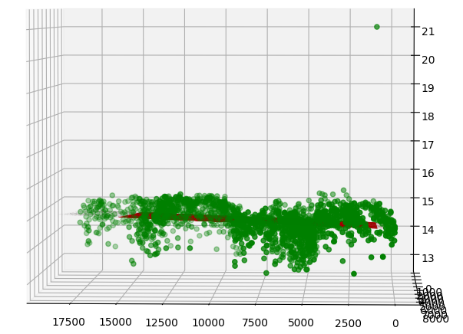
5.6 seconds for all processing with 12 tiles

Slide 7
Autofocus
New auto focus will utilize the 3 images from autofocus and project out what the approximate ideal exposure would be.

Slide 8
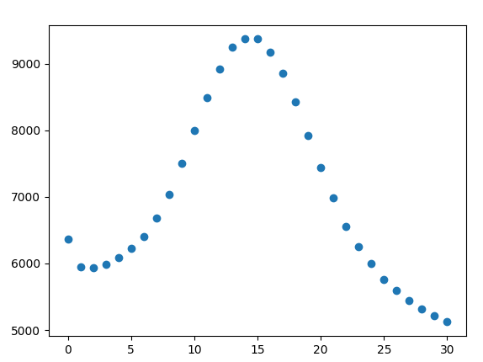
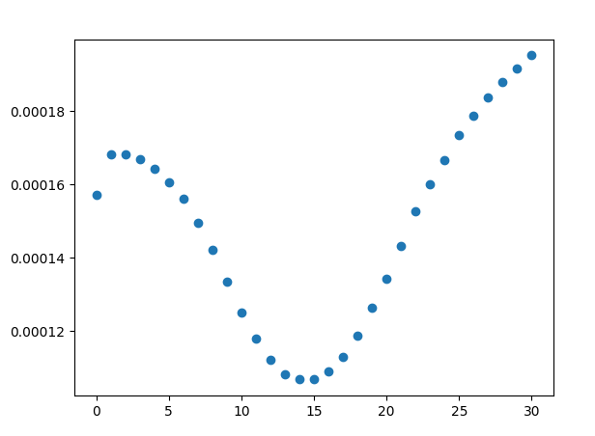
Plot highest int value of the bottom 99% pixels vs slice in image array
Also plot 1/highest pixel
Plot z slices 7-22 and fit reciprocal to quadratic equation
Fits very well!

Slide 9
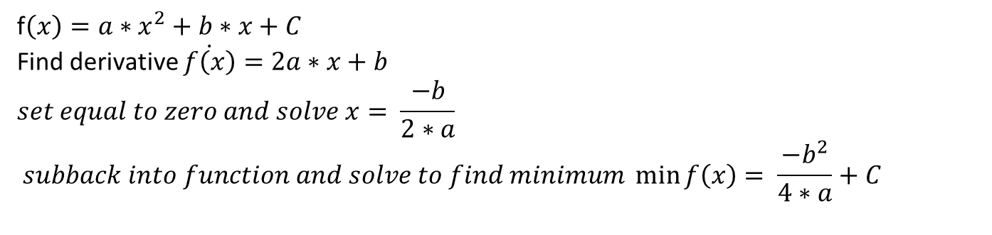
Intertwining Auto Focus and Auto exposure
f$\left(x\right)=a∗x^{2}+b∗x+C$
Find derivative $\dot{f\left(x\right)}=2a∗x+b$
$$set equal to zero and solve x= \frac{−b}{2∗a}$$
$$subback into function and solve to find minimum \min_{}{f\left(x\right)= \frac{−b^{2}}{4∗a}+C}$$

